Slide 1
ML Python Toolkit
UCSB Presentation

Slide 2
Python

Slide 3
Anaconda Installation
Install Anaconda: https://conda.io/docs/user-guide/install/index.html

Slide 4
Github Link
https://github.com/hmfrank/sbhacks_mnist

Slide 5
Virtual Environment
A self-contained directory tree that contains a Python installation for a particular version of Python, plus a number of additional packages
Venv - https://docs.python.org/3/tutorial/venv.html Also Install Virtual Environment Wrapper - https://realpython.com/python-virtual-environments-a-primer/
Notes:
which python outside and inside

Slide 6
Virtual Environment - Conda
Conda command - conda create --name <virtualenv name> python=<version>
Example: conda create --name 3point6 python=3.6
Conda: https://conda.io/docs/user-guide/tasks/manage-environments.html
Activate environment: conda activate workshop
Deactivate: conda deactivate
Remove environment: conda env remove --name <name>

Slide 7
Flask

Slide 8
Flask - A micro framework for Python
built-in development server and debugger
integrated unit testing support

Slide 9
Installation
pip install flask
or
conda install flask

Slide 10
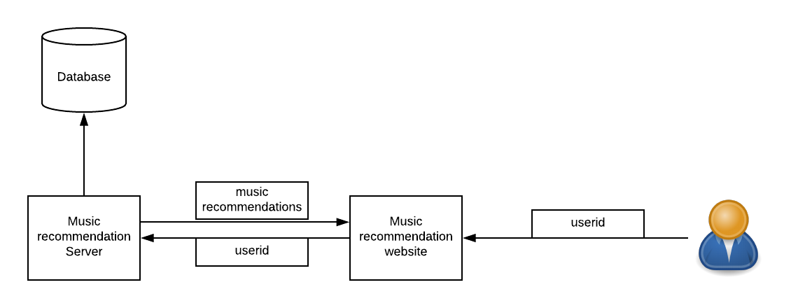
Example Architecture

Slide 11
GET vs POST
POST
Create, Update, Delete operations
No size limit
GET
Safe and idempotent
Sent in the URL
Size limit

Slide 12
Jupyter Notebooks
create and share documents that contain live code, equations, visualizations and narrative text

